Slide 1

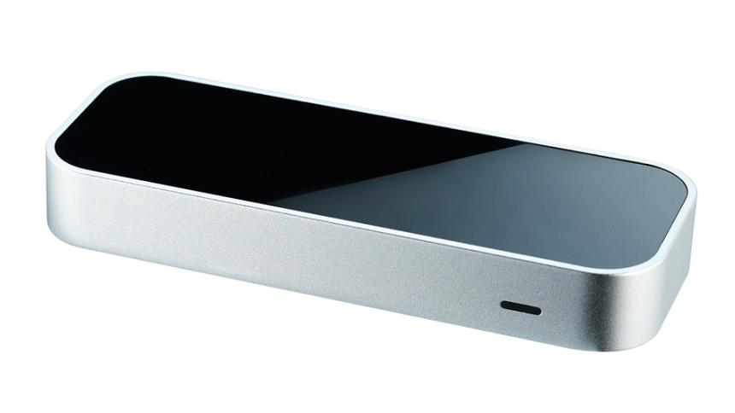
PROJECT FOR GESTURE BASED UI DEVELOPMENT
Gary Mannion
&
Derrick conway

Slide 2
PROJECT OUTLINE
Create a simple command line application that is being controlled by Leap Motion.
Leap Motion will be connected to an Arduino board
Arduino board will be plugged into a Breadboard circuit with some LEDs to prove the gestures are working.

Slide 3
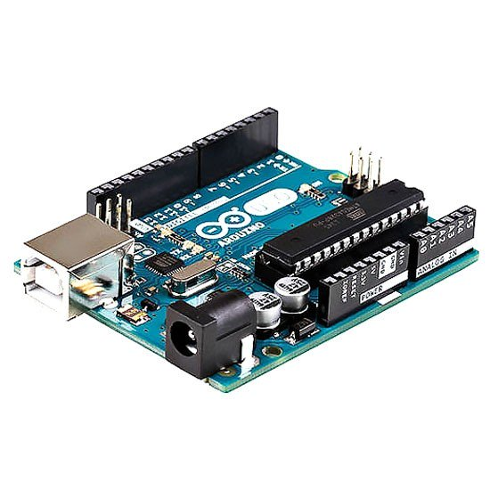
Languages
JavaScript
Tools Used
Breadboard circuit
Arduino
Leap Motion
OS
Linux Mint

Slide 4
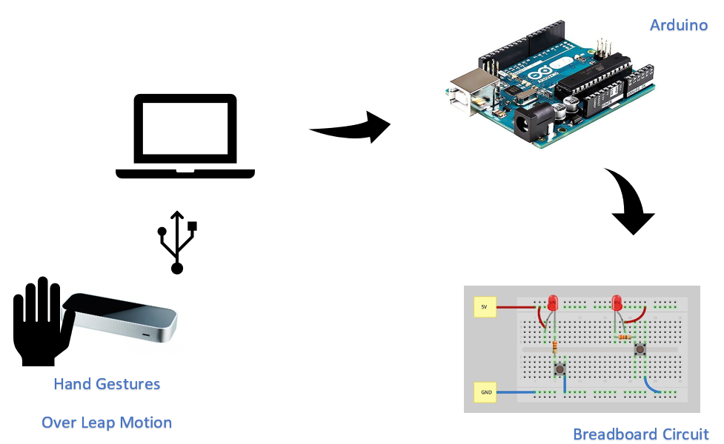
ARCHITECTURE

Slide 5
TIMELINE
FEB
MAR
APR
Research & Planning
Project implemented
Documentation & Final Touches
Research of the project and what route to pursue in development
Downloading of SDK needed, configuration of tools and coding up Arduino with Leap Motion.
Finishing off all documentation and preparing for presentation.

Slide 6

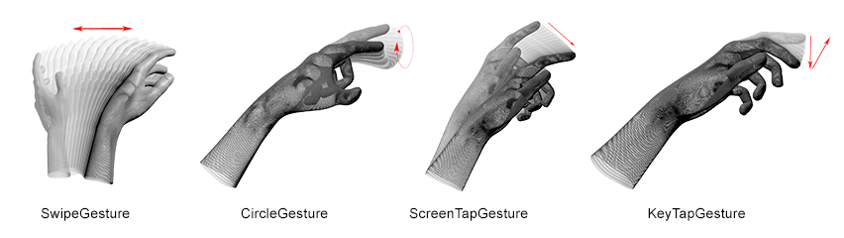



GESTURES

Slide 7
Problems during development
Access denied on port to Arduino
Connection issue within Arduino IDE have to give read/write access
Leap Motion Visualizer
Issue when connecting to Leap Motion Controller and getting visualizer to open up to view hand control

Slide 8
DEMO
https://www.youtube.com/watch?v=izteI-euwgo&feature=youtu.be

Slide 9
CONCLUSION
Pros
Demonstrates how the Leap Motion controller can be used in web applications
Any issues were easily fixed as other people has the same problems
Cons
Can occasionally be glitchy when performing gestures
Arduino configurations can sometimes throw up errors.

